Slide 1
Exercise 4 Increasing Well-Being with Data Analytics
Sommerterm 2022
Notes:
Lassen Sie uns starten. Ich darf Sie recht herzlich begrüßen zur Veranstaltung IbG, eine Veranstaltung, die in den Themenbereich Entrepreneurship fällt.

Slide 2
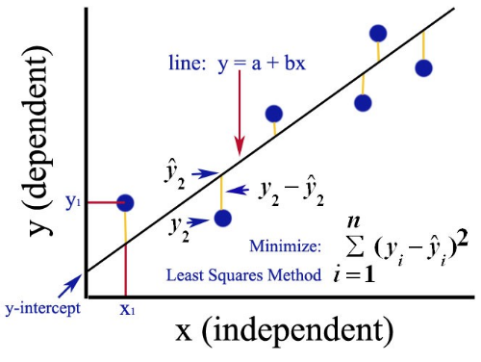
Fundamental Regression Model: Ordinary Least Squares (OLS)
OLS: method for estimating the unknown parameters in a linear regression model.
line: ŷ = Xβ
cross-sectional data
Sources:
https://medium.com/analytics-vidhya/ordinary-least-square-ols-method-for-linear-regression-ef8ca10aadfc; https://en.wikipedia.org/wiki/Ordinary_least_squares

Slide 3


Advanced Regression Analysis: Panel Regression Model
Panel data are collected over more than two dimensions (i.e., time, individuals, and some third dimension).
$y_{it}$(dependent)
1
T = 4
2
cross-sectional and longitudinal data
3
$x_{it}$(independent)
Sources:
https://en.wikipedia.org/wiki/Panel_analysis#:~:text=Panel%20(data)%20analysis%20is%20a,run%20over%20these%20two%20dimensions.

Slide 4
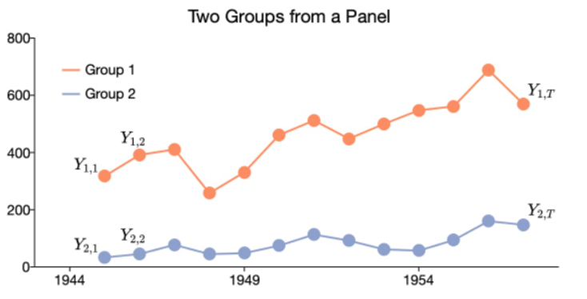
Example Panel Data
Group | Time Period | Notation
1 | 1 | Y₁₁
1 | 2 | Y₁₂
1 | 3 | Y_{1T}
. . . | . . . | . . .
N | 1 | Y_{N1}
N | 2 | Y_{N2}
N | T | Y_{N3}
Sources:
https://www.aptech.com/blog/introduction-to-the-fundamentals-of-panel-data/

Slide 5
Wellbeing Panel Data
ID | Wellness Activity | Life Satisfaction | Social Media Time | Date
1 | 0 | 4 | 100 min/d | 22/05/2021
1 | 1 | 6 | 88 min/d | 30/05/2021
1 | 1 | 7 | 88 min/d | 07/06/2021
2 | 0 | 4 | 132 min/d | 22/05/2021
2 | 1 | 4 | 147 min/d | 30/05/2021
2 | 1 | 5 | 121 min/d | 07/06/2021
. . . | . . . |  |  | . . .
N | 0 | 4 | 39 min/d | 22/05/2021
N | 1 | 6 | 29 min/d | 30/05/2021
N | 1 | 6 | 32 min/d | 07/06/2021

Slide 6
Advanced Regression Analysis: Panel Regression Model
Panel data are collected over more than two dimensions (i.e., time, individuals, and some third dimension).
Independently pooled panels
There are no unique attributes of individuals
within the measurement set, and no universal effects across time.
BUT: Actually, different intercepts for every individual necessary
unobserved heterogeneity
$y_{it}$(dependent)
1
T = 4
2
3
POLS
$x_{it}$(independent)
Sources:
https://en.wikipedia.org/wiki/Panel_analysis#:~:text=Panel%20(data)%20analysis%20is%20a,run%20over%20these%20two%20dimensions.

Slide 7



Advanced Regression Analysis: Panel Regression Model
Panel data are collected over more than two dimensions (i.e., time, individuals, and some third dimension).
Fixed effects model:
There are unique attributes of individuals that do not vary over time
Random effects model:
There are unique, time constant attributes of individuals that are not correlated with the individual regressors.
$y_{it}$(dependent)
1
T = 4
2
3
$$α_{1}$$
POLS
$$α_{2}$$
$x_{it}$(independent)
$$α_{3}$$
Sources:
https://en.wikipedia.org/wiki/Panel_analysis#:~:text=Panel%20(data)%20analysis%20is%20a,run%20over%20these%20two%20dimensions.

Slide 8
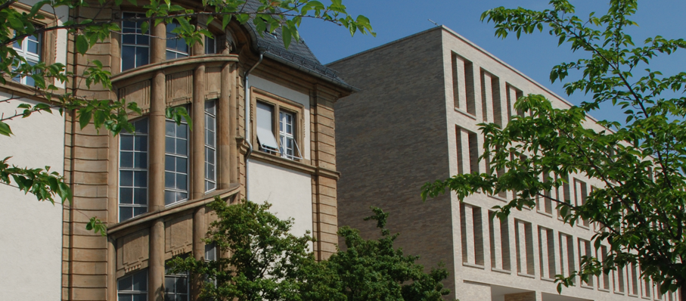
Thank you!

